Slide 1
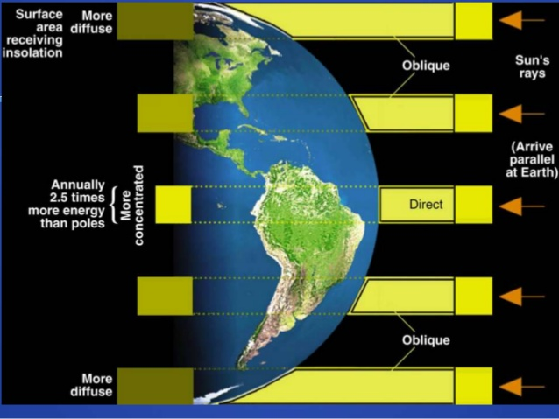
A birds-eye view of what we’ve seen in the GCMs: Excess of heat at the equator drives weather
An imbalance in energy from the sun creates an excess of heat at the equator.

Slide 2
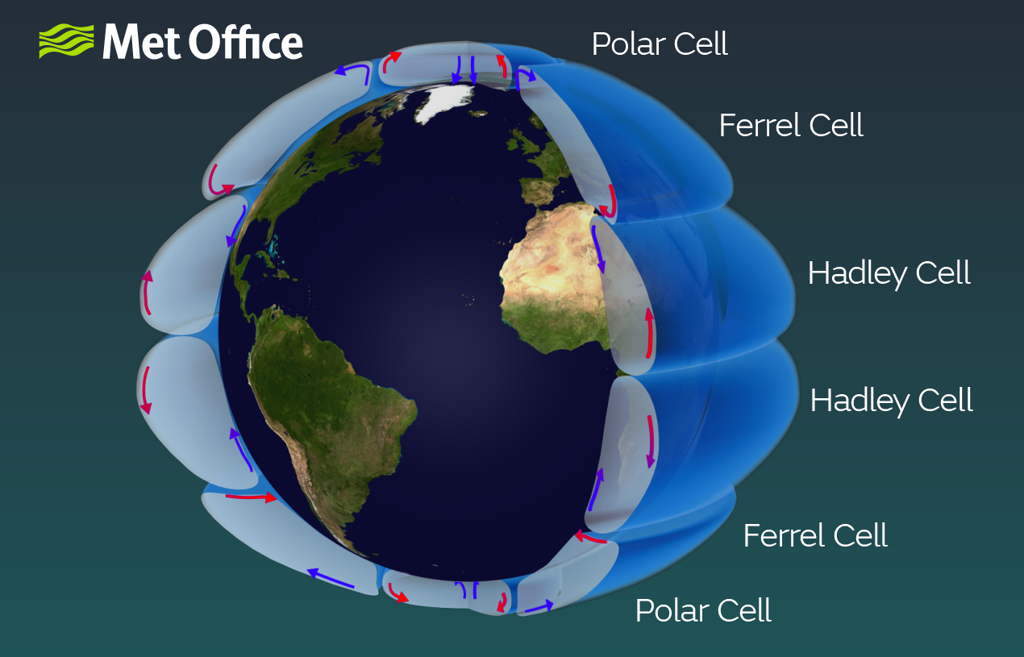
Large air circulation patterns are responsible for deserts and rainforests
We can expect that these cells:
Will become more intense
=> The hydrologic cycling that goes along with increased intensity will lead to more drought and more rainfall (“James Hansen’s “Storms of my Grandchildren”)
As boundaries between cells shift poleward, greatest changes there (e.g. Santiago, San iego

Slide 3
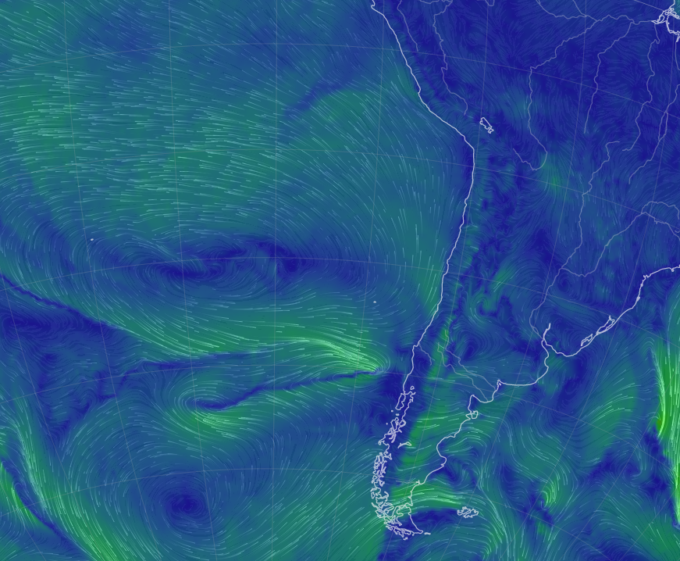
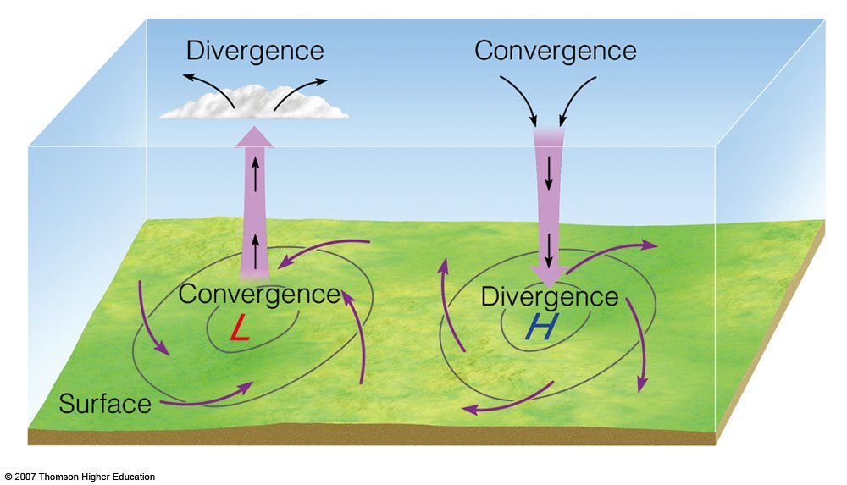
Also true that there’s a (counter-intuitive) slowing down of synoptic systems
Rising air
Subsiding air
Anticyclonic system
Semi-permanent high-pressure (anticyclonic) systems stick around longer, hence droughts are more persistent.

Slide 4
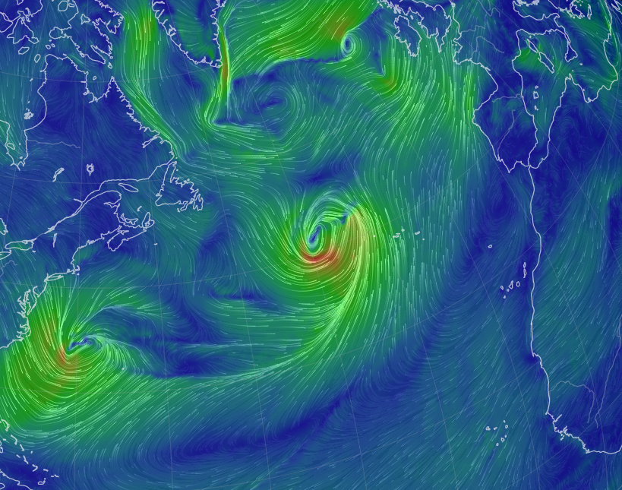
Also true that there’s a (counter-intuitive) slowing down of synoptic systems
Rising air
Subsiding air
Cyclonic system
Semi-permanent low-pressure (cyclonic) systems stick around longer, hence rainfall events are more persistent (e.g., PR 2022).

Slide 5
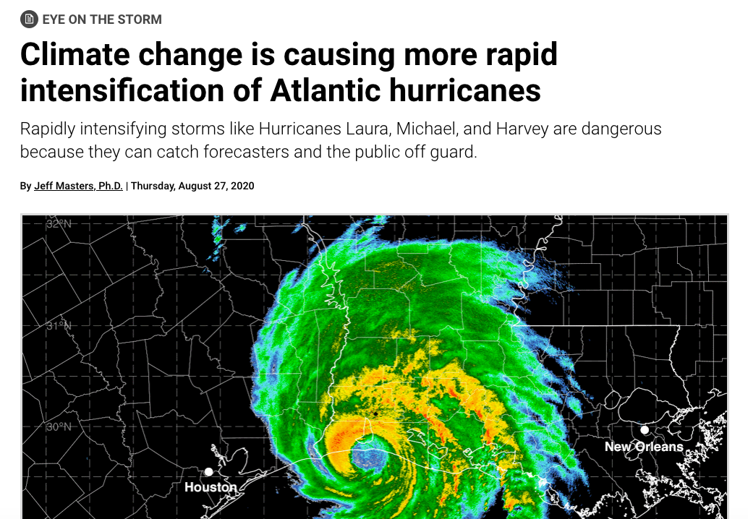
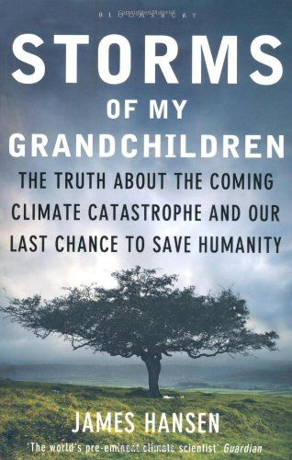
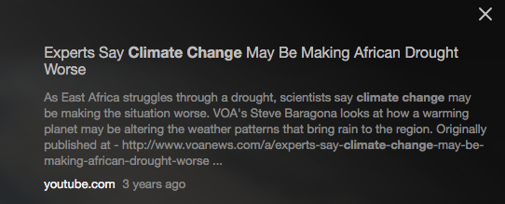
A good comprehensive summary: https://climate.nasa.gov/effects/
Overall warmer (consequences: human health, accelerated rate of extinctions)
Accelerated circulation (consequences: wetter and drier; more intense hurricanes)
Changes in semipermanent synoptic systems (droughts)
https://youtu.be/DK1uKpJ49Jo

Slide 6
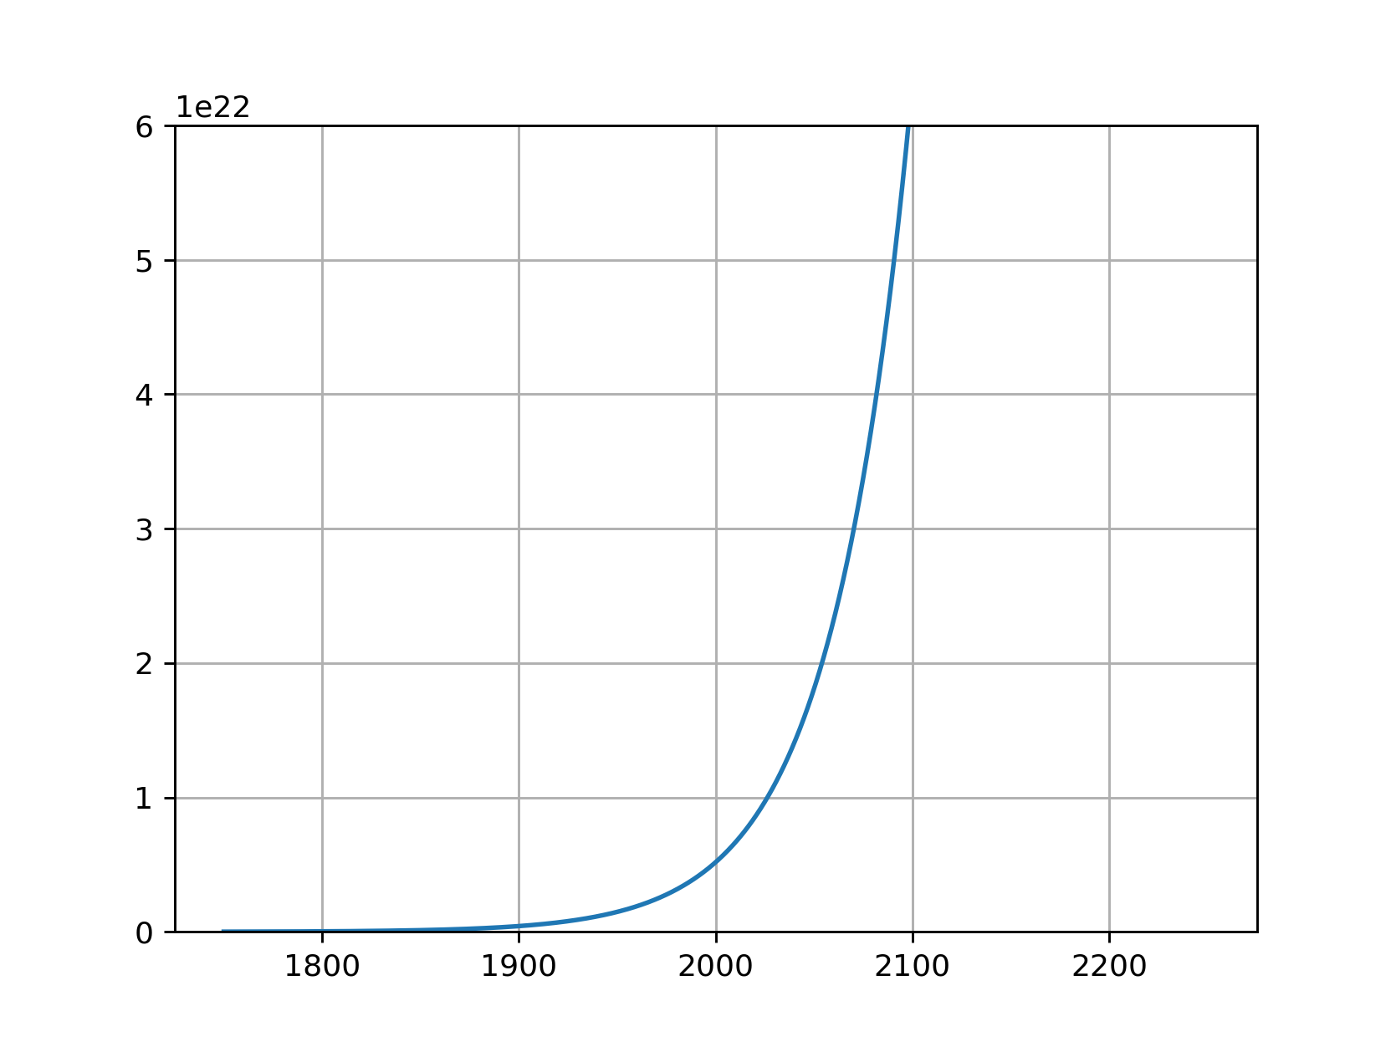
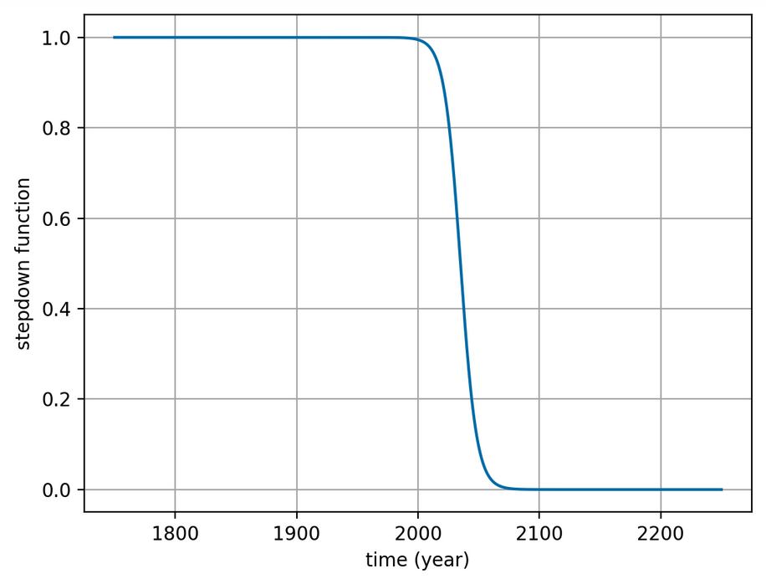
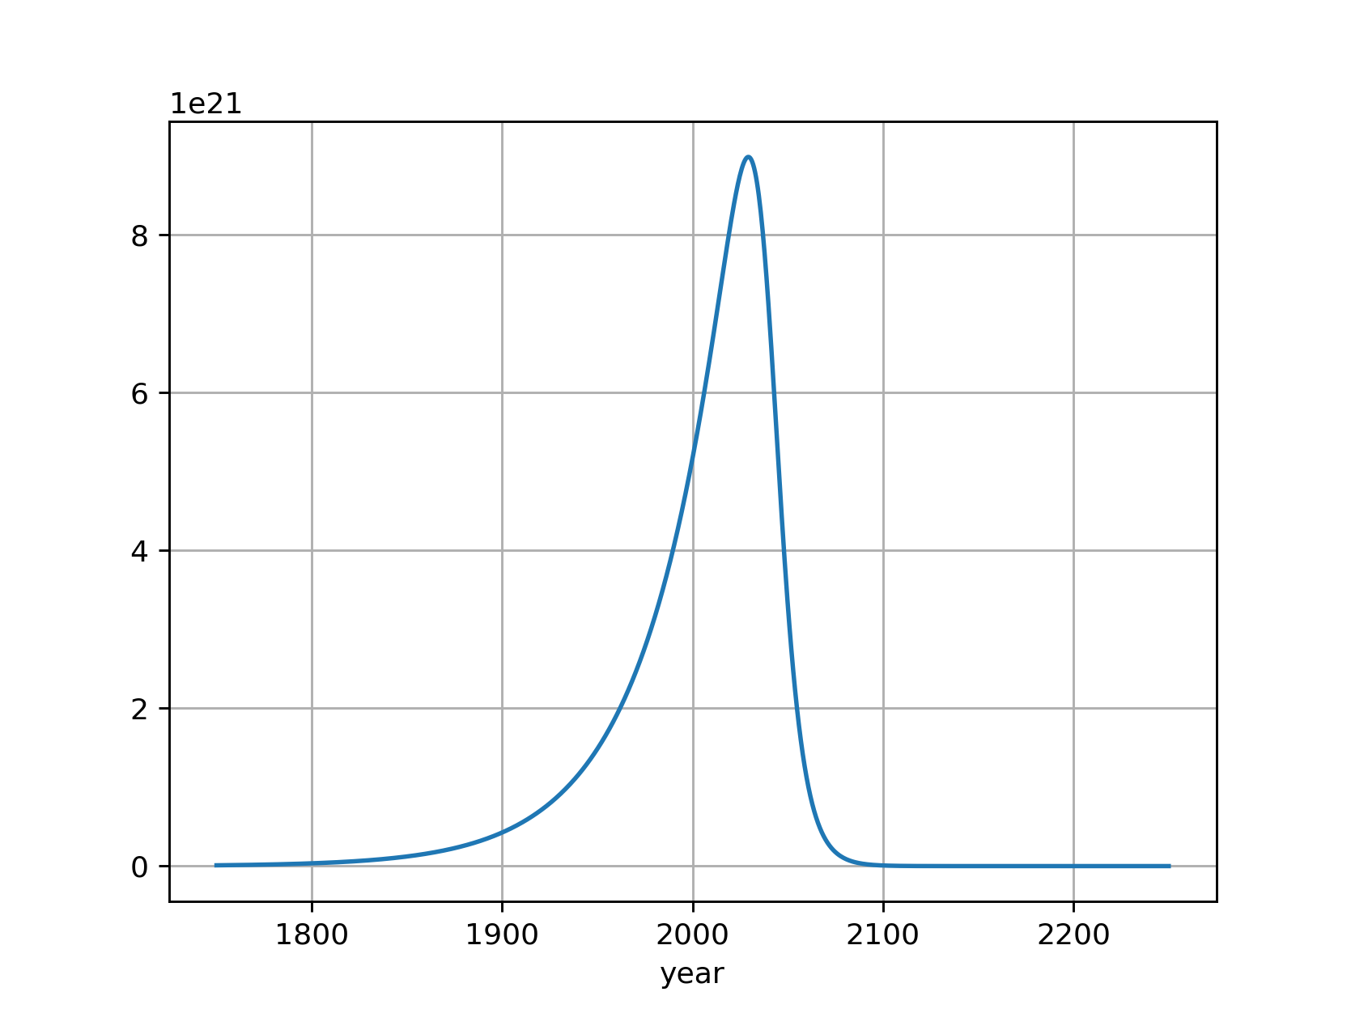



Looking ahead: Mathematical representation of emissions
Past exponential growth
$$exp⁡(kt)$$
Future elimination of Carbon emissions (the “cold turkey”) option
$$σ_{down}$$
Combined
$${\exp\left(kt\right)× σ}_{down}$$

